Slide 1
PDA’s from Snowstorms to Tornados

Slide 2
Agenda
Introductions
FEMA Public Assistance
Personal PA History
Thresholds
Eligible Applicants
Eligible Costs
Tracking Costs
Insurance
FEMA Submissions
Appeals
Lessons Learned
Best Practices
Questions & Answers

Slide 3
Introductions
Susan Mongold
Virginia Department of Emergency Management
Kristen Fagan
College of William and Mary

Slide 4
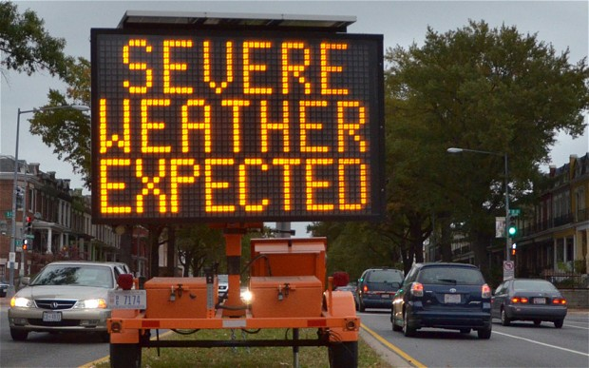
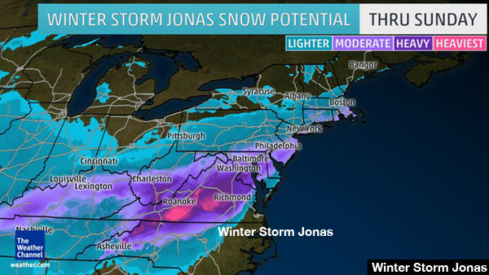
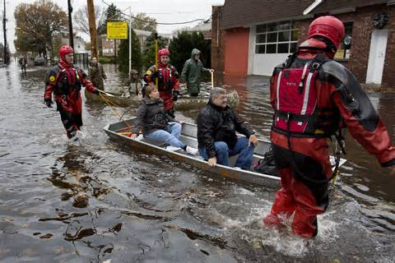
Declared Events in Virginia
December 2009 Snow Storm
Snowmageddon 2010
Tropical Storm Lee 2011
Earthquake 2011
Hurricane Irene 2011
Hurricane Sandy 2012
Winter Storm Jonas 2016

Slide 5
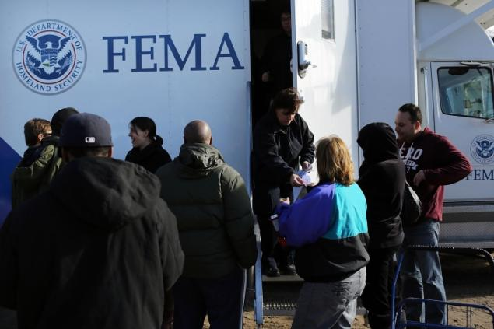
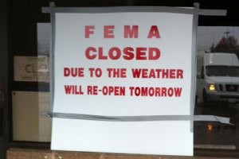
FEMA Public Assistance
Public Assistance Program provides aid in the wake of a major disaster. FEMA provides supplemental Federal disaster grant assistance for debris removal, emergency protective measures, and the repair, replacement, or restoration of disaster-damaged, publicly owned facilities and the facilities of certain Private Non-Profit (PNP) organizations.
The Federal share of assistance is not less than 75% of the eligible cost. The Recipient (usually the State) determines how the non-Federal share (up to 25%) is split with the subrecipients (eligible applicants).

Slide 6
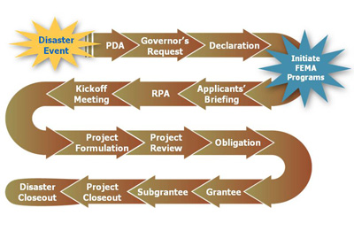
FEMA Public Assistance Process

Slide 7
Public Assistance Qualifying Thresholds
Federal PA Program
2016 Thresholds:
State: $1.41 per capita (
State Threshold: $11,281,443 based on 2010 population of 8,001,024
Local: $3.57 per capita
Example: With a 2010 population of 33,164, Accomack County’s threshold under this program is $118,395
Project Categorization:
Small Projects: minimum amount $3,050
Large Projects: minimum amount $121,800

Slide 8
The Preliminary Damage Assessment
The Preliminary Damage Assessment (PDA) process is a mechanism used to determine the impact and magnitude of damage and resulting needs of individuals, businesses, public sector, and community as a whole. Information collected is used by the State as a basis for the Governor’s request for a major disaster or emergency declaration, and by the President in determining a response to the Governor’s request.
Summary of Damage Assessment Information Used in Determining Whether to Declare a Major Disaster : Public Assistance Request from the Commonwealth of Virginia for Storm Jonas 2016
Primary Impact: Emergency Protective Measures
Total Public Assistance cost estimate: $40,548,769
Statewide per capita impact: $5.07
Statewide per capita impact indicator: $1.41
Countywide per capita impact: Albemarle County ($8.14), Arlington County ($8.92), Caroline County ($18.36), Clarke County ($12.78), Culpeper County ($9.84), Fairfax County ($17.58), Fauquier County ($17.97), Frederick County ($11.68), Highland County ($23.69), King George County ($10.66), Loudoun County ($14.32), Louisa County ($12.95), Madison County ($21.61), Page County ($3.93), Patrick County ($6.45), Prince William County ($13.15), Rappahannock County ($16.86), Spotsylvania County ($9.73), Stafford County ($11.41), and Warren County ($9.88) and Alexandria City ($6.04), Falls Church City ($10.17), Manassas City ($4.81), Manassas Park City $5.12), and Winchester City ($9.50).
Countywide per capita impact indicator: $3.57

Slide 9
Who’s Eligible for Public Assistance
Counties and Parishes
Cities, Towns, Boroughs
Water Districts
Council of Governments
State Recognized Tribes
State Agencies
Colleges and Universities
School Districts
Non-Profits
Hospitals
Volunteer Fire Departments
Utilities

Slide 10
Categories of Work
Emergency Work – 6 months to complete
Category A: Debris Removal
Category B: Emergency Protective Measures
Permanent Work – 18 months to complete
Category C: Roads and Bridges
Category D: Water Control Facilities
Category E: Buildings and Equipment
Category F: Utilities
Category G: Parks, Recreational, and Other Facilities
Note: You can request time extensions

Slide 11
Eligible Costs
Debris Removal
Damage Assessment
Emergency Protective Measures including public safety, public works, shelter operations, EOC operations - costs directly related to disaster response
Repair, replacement, or restoration of disaster-damaged property
Public facilities located in a designated disaster area, under the legal responsibility of an eligible applicant, in active use at the time of the disaster, and open to the general public

Slide 12
Tracking Costs
Discuss prior to incident occurring with all applicable parties (Finance POCs, HR, Supervisors, Project Managers) to create a common understanding of documentation goals.
Utilize common, easy to use templates for capturing financial data.
Use Internal Tracking Systems – Job Numbers, Fire Records Management System, Computer Aided Dispatch, FAMIS (Facilities Administration Management Information System).
Create E-mail distribution/emergency PA notification lists.
Clear, Consistent communication with stakeholders

Slide 13
Event Cost Estimates Sample

Slide 14
Event Cost Estimates Sample
The College of William and Mary
Hurricane Irene - August 2011
Estimates
Department | Category | Labor | Material | Equipment Use | Lodging | MISC | Total:
Facilities Management | A | $ 16,426.02 |  | $ 17,516.44 |  | $ 44,784.68 | $ 78,727.14
Athletics | B |  |  |  |  | $ 25,071.00 | $ 25,071.00
Police Department | B |  |  |  | $ 375.00 |  | $ 375.00
Reves Center | B |  |  |  | $ 4,107.00 | $ 2,604.07 | $ 6,711.07
FM | B | $ 1,553.74 | $ 1,583.86 | $ 10,747.90 | $ 797.30 | $ 5,350.00 | $ 20,032.80
FM | D |  |  |  |  | $ 1,120.00 | $ 1,120.00
Biology | E |  |  |  |  | $ 1,620.97 | $ 1,620.97
FM | E | $ 40,990.49 | $ 5,145.00 |  |  | $ 239,584.41 | $ 285,719.90
Kinesiology | G | $ 1,165.00 | $ 500.00 |  |  |  | $ 1,665.00
FM | G |  |  |  |  | $ 3,177.00 | $ 3,177.00
Athletics | G |  |  |  |  | $ 1,475.00 | $ 1,475.00
Grand Total: |  |  |  |  |  |  | $ 425,694.88

Slide 15
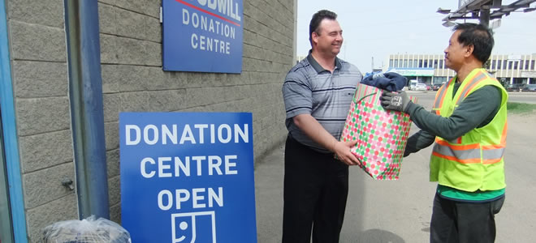
Donated Resources/Volunteer Tracking
Designate a single point of contact/volunteer manager
Designate a location for volunteer check in and donation management
Utilize a simple form for tracking time and job assignment

Slide 16
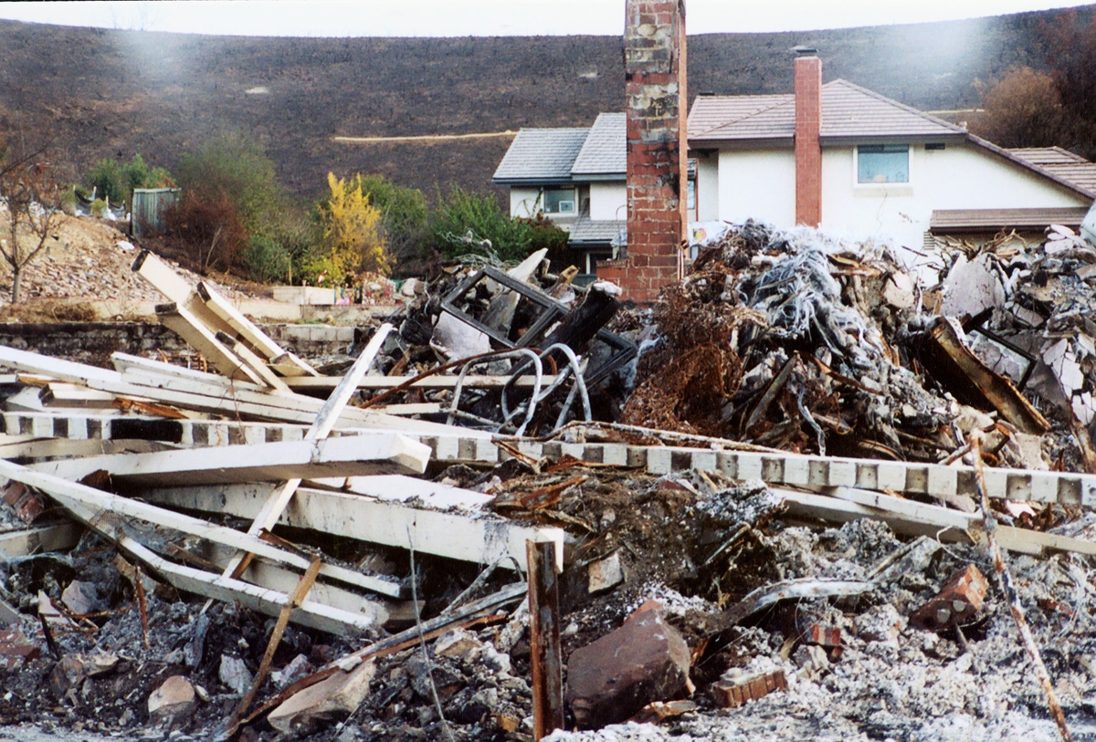
Debris Removal
Create a Debris Removal Plan (Debris Management Guide, FEMA P-325/July 2007)
Establish debris removal contracts
Establish debris disposal sites
Hire/Designate a Debris Monitor (cost is reimbursable and monitoring is required)
Environmental Health and Safety
Forms - Load tickets, etc.

Slide 17
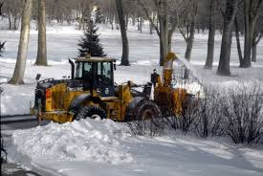
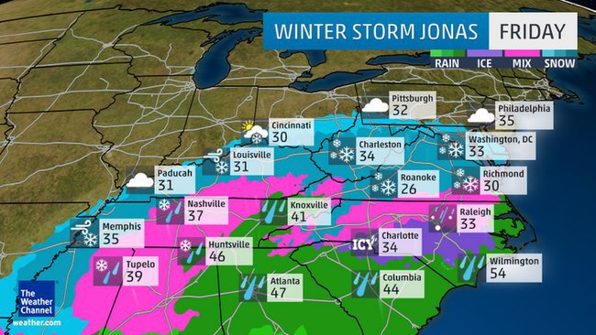
Snow Removal
Create a Snow Removal Plan
Determine 48 hour snow removal period (Most $$ spent)
Establish priorities/level of service
Track Personnel and equipment used
Maps
Use contractual work if possible and have vendor line item each day of snow removal to isolate 48 hour period

Slide 18
Insurance
Have a copy of your policy available for review
Know what's covered (snow removal to critical facilities?)
Know your deductible and how it is applied
Your deductible can be reimbursed by FEMA
Have your insurance representative be a part of the damage assessment process with FEMA
Fairfax County Insurance
Property Damage – Independent insurance company coverage
$125,000 deductible
$1,000,000 deductible for property within a flood plain
Equipment Damage – self insured, paid from insurance fund
Liability - Independent insurance company coverage
$1,000,000 deductible
William & Mary
Property/Equipment Damage – covered under the Risk Management Plan, administered by the Division of Risk Management
$10,000 deductible

Slide 19
FEMA Submissions
Review FEMA PA Policy for documentation guidelines
Provide good detail on your Project Worksheets – to include: location, extent of damage, scope of work, any special considerations and costs (estimated or actual)
Designate a POC to manage all submissions – so
everyone is on the same page with documentation
and policies
All large projects must have 100% documentation
Check FEMA’s Work – review everything before
signing off

Slide 20
FEMA Decisions and Appeals
Eligibility can be determined based on interpretation of FEMA policy
Be very detailed with your Project Worksheet Scope of Work
Discuss concerns with VDEM and FEMA
Confer with surrounding jurisdictions for eligibility and methodology
Consult jurisdiction attorney for assistance with eligibility issues
Seek assistance from local and state politicians

Slide 21
Lessons Learned
Be sure you are listed on debris removal contracts – cannot piggyback
Approach each work request as a reimbursable project; photograph and document everything before, during and after.
Be aware of any historical sites with damage and let FEMA know immediately
Be up-to-date on all FEMA guidelines
Debris removal – must document EVERYTHING!!!!
FEMA & VDEM people change OFTEN so having your documentation as accurate and organized as possible is a benefit to you in the long run (you may be asked for the same information numerous times during the reimbursement period)

Slide 22
Best Practices
Continually review your plans
Mitigation
Planning, evaluation and testing
Setup simple templates for information collection
Know the “go to people” to get the information
Hire a contractor to assist with your submission (work on PWs is reimbursable)

Slide 23
Questions?
Thank you!
Contact Information
Susan Mongold
Susan.Mongold@vdem.virginia.gov
Kristen Fagan, Risk Manager, William & Mary
kdfaga@wm.edu
Diane Hansen, Fiscal Administrator, Fairfax County OEM
Diane.Hansen@fairfaxcounty.gov

